Slide 1

Progressive Education Society’s Modern College of Arts, Science & Commerce (Autonomous) Shivajinagar, Pune - 411005
Statistics project on
Analysis of major crops-
Sugarcane and Wheat produced in INDIA

Slide 2

Introduction:
As we know population growth is rapidly accelerating. This, in turn, leads to higher demand for food and food products .
Therefore it is important to analyze agricultural trends and variables affecting the production process in order to optimize the meet the food requirements.

Slide 3
Objective:
Our project aims to
Analyze crop yield and production of two of the major crops produced in INDIA-Sugarcane and Wheat.
Identify factors influencing agricultural productivity that are Area used , Rainfall, Fertilizers and Pesticides used.

Slide 4
Sample Data
Data used in the project is collected from www.Kaggle.com,
Which is primarily sourced and integrated from
data.gov.in
2. https://www.fao.org/faostat/en/#data
3. https://data.gov.in/catalog/rainfall-india
4. https://environicsindia.in/
5. https://www.imdpune.gov.in/library/public/e-book110.pdf

Slide 5
Variables
1.Area: The total land area (in hectares) under cultivation for the specific crop.
2. Production: The quantity of crop production (in metric tons).
3. Annual Rainfall: The annual rainfall received in the crop-growing region (in mm).
4. Fertilizer: The total amount of fertilizer used for the crop (in kilograms).
5. Pesticide: The total amount of pesticide used for the crop (in kilograms).
6. Yield: The calculated crop yield (production per unit area).

Slide 6

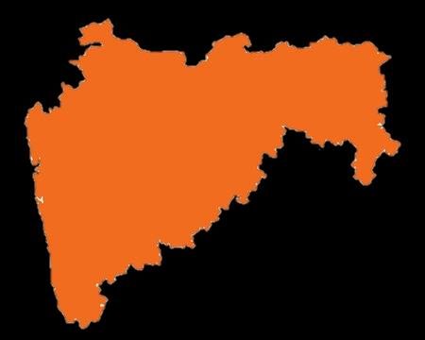


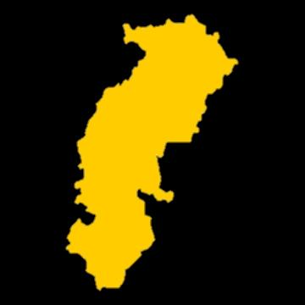
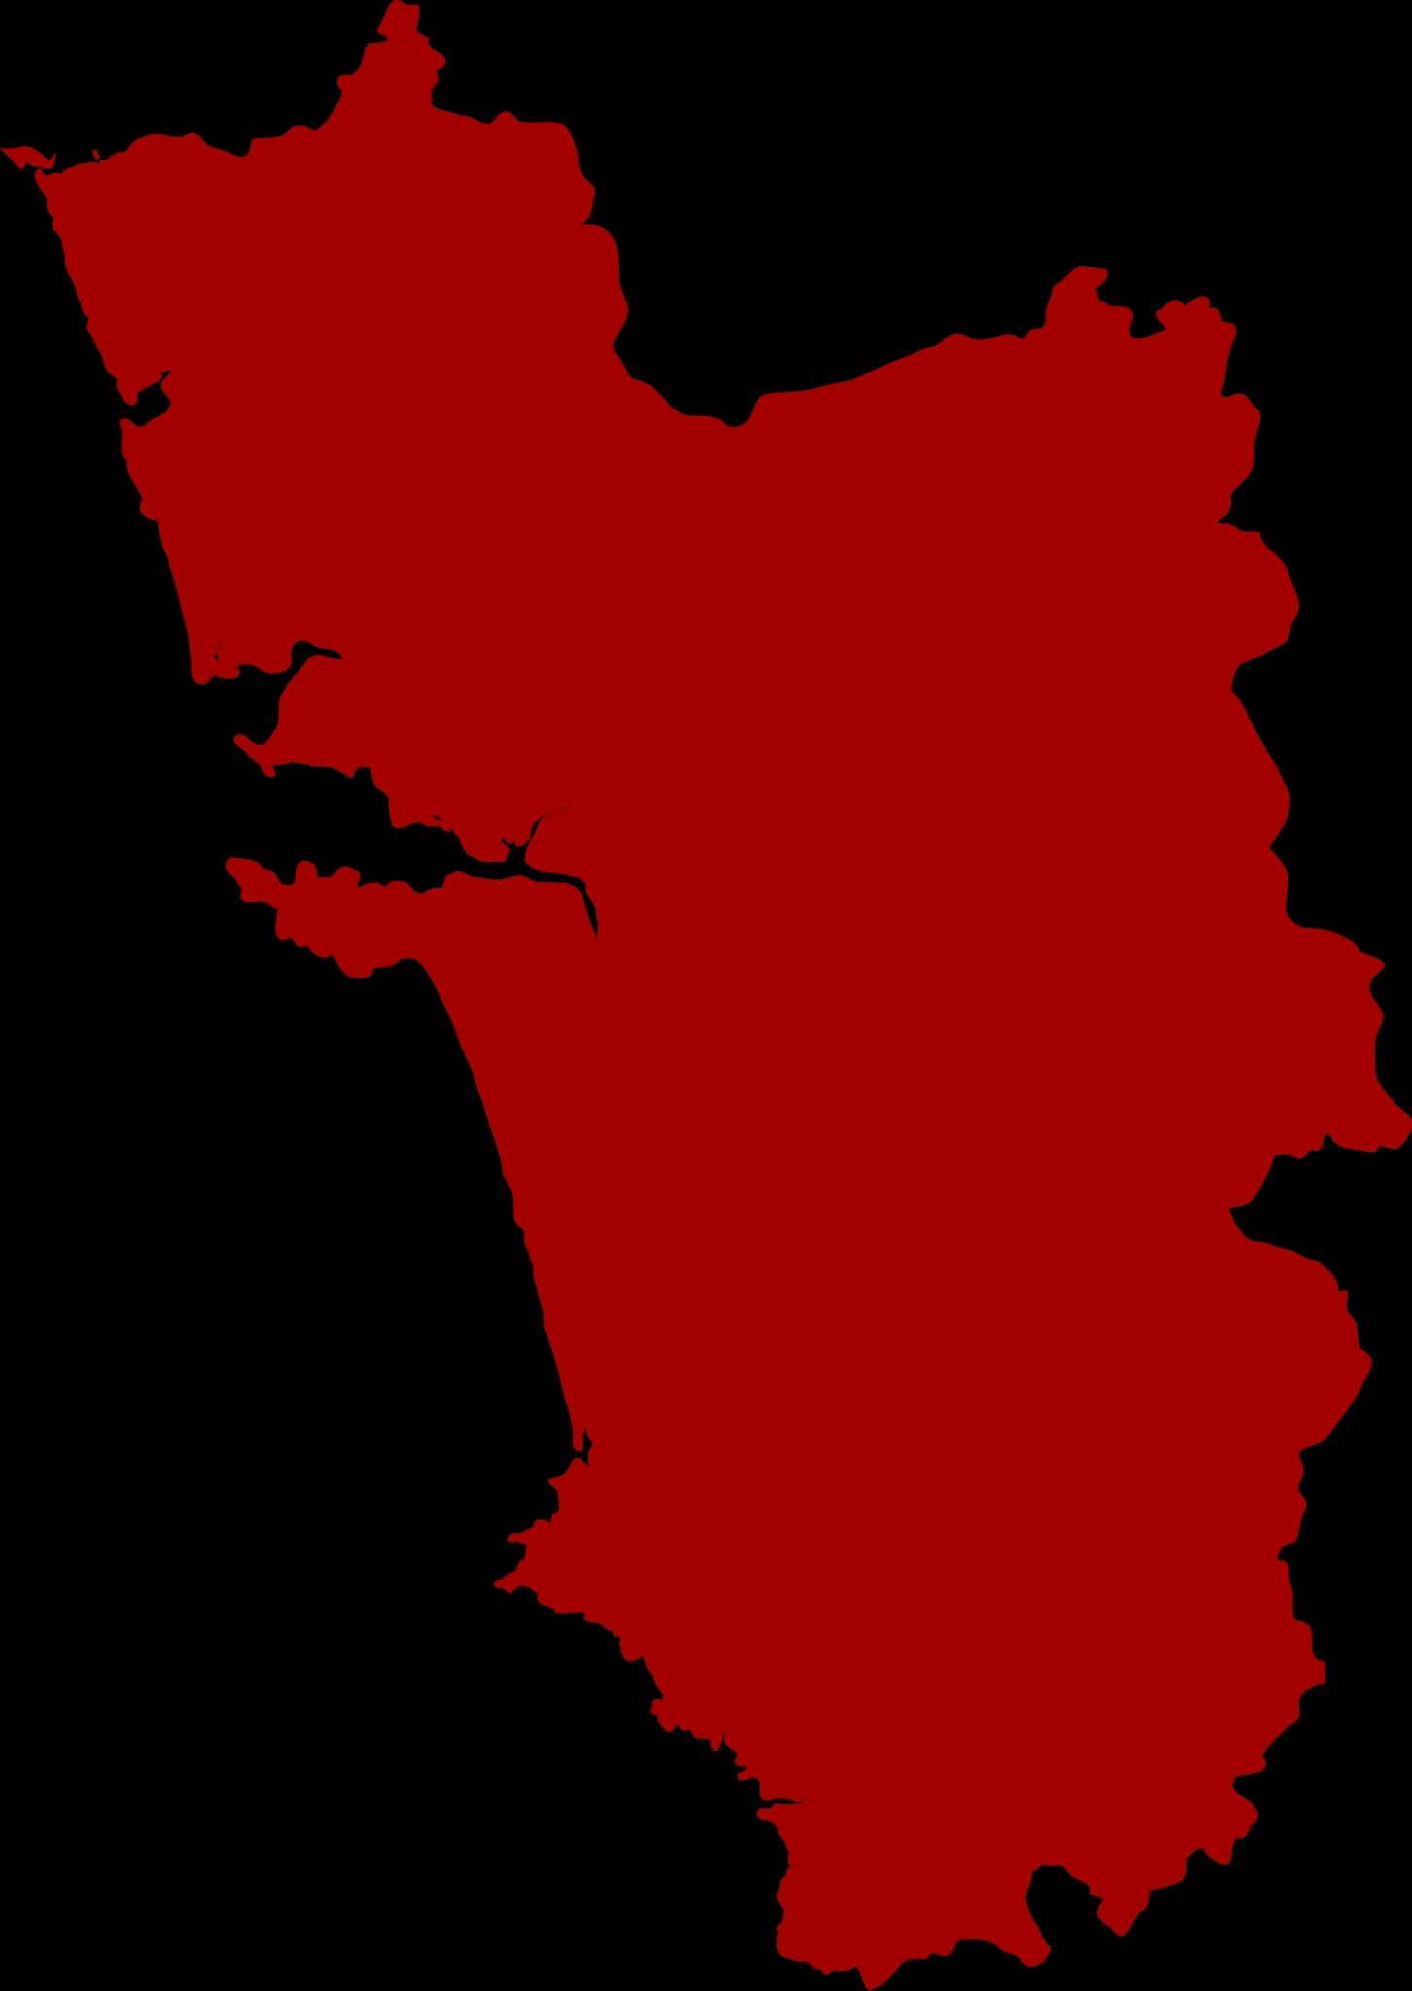

Comparison of production of sugarcane and wheat between Maharashtra and states with one of the highest and lowest yields.
Comparison of production of sugarcane and wheat between Maharashtra and states with one of the highest and lowest yields.
Maharashtra
Maharashtra
Goa
Chhattisgarh
Gujarat
Karnataka

Slide 7
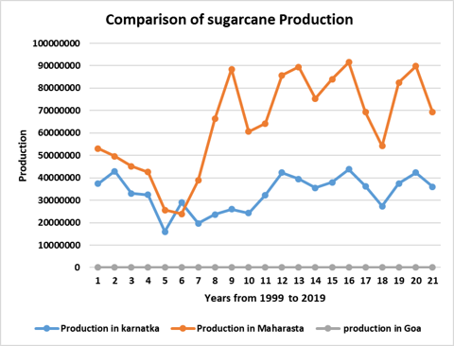
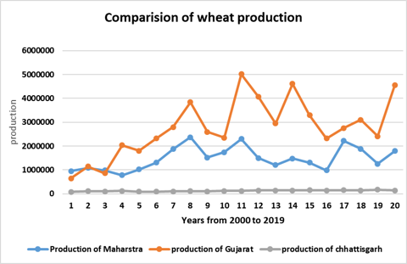
b
Graphical representation

Slide 8
Correlation between wheat production and variables affecting the production.
Correlation between sugarcane production and variables affecting the production.
Correlation coefficient between Area and production : 0.967043
Correlation coefficient between Annual rainfall and production : 0.306006154
Correlation coefficient between Fertilisers and production : 0.944137894
Correlation coefficient between pesticide and production : 0.776000285
Correlation coefficient between Area and production : 0.928736
Correlation coefficient between Annual rainfall and production : 0.465756
Correlation coefficient between Fertilisers and production : 0.874769
Correlation coefficient between Pesticide and production : 0.44734

Slide 9
Regression model on sugarcane produced and factors affecting the production.
Regression model on sugarcane produced and factors affecting the production.

Slide 10
Regression model on sugarcane produced and factors affecting the production.
Regression model on wheat produced and factors affecting the production.

Slide 11
Analysis using T-test
Hypothesis:
Null Hypothesis (H0): The true difference in means between the variables affecting production of crop of two states is equal to zero.
Alternative Hypothesis (H1): The true difference in means between the variables affecting production of crop of two states is not equal to zero.
Decision:We accept null hypothsis when calculated p value is greater than alpha i.e 0.05.
When we have p value greater than alpha we do not have sufficient evidence to reject null hypothesis.

Slide 12
Comparison of production of sugarcane between Maharashtra and Goa and factors affecting it.
Variables | Conclusion
Yield | Reject the null hypothesis Maharashtra has higher yield
Area | Reject the null hypothesis Maharashtra use large area than goa for sugarcane.
Production | Reject the null hypothesis Maharashtra has higher production than goa.
Annual Rainfall | Reject the null hypothesis Goa has higher rainfall than Maharashtra.
Fertilizers | Reject the null hypothesis More fertilizer is used in Maharashtra.
Pesticides | Reject the null hypothesis More pesticide is used in Maharashtra.

Slide 13
Comparison of production of sugarcane between Maharashtra and Karnataka and factors affecting it.
Variables | Conclusion
Yield | Reject the null hypothesis Karnataka has higher yield than Maharashtra.
Area | Reject the null hypothesis Maharashtra use large area than Karnataka for sugarcane.
Production | Reject the null hypothesis Maharashtra has higher production than Karnataka.
Annual Rainfall | Accept the null hypothesis Both the states receive same rainfall.
Fertilizers | Reject the null hypothesis More fertilizer is used in Maharashtra.
Pesticides | Reject the null hypothesis More pesticide is used in Maharashtra.

Slide 14
Comparison of production of wheat between Maharashtra and Chhattisgarh and factors affecting it.
Variables | Conclusion
Yield | Reject the null hypothesis Chhattisgarh has higher yield
Area | Reject the null hypothesis Maharashtra use large area than Chhattisgarh for wheat.
Production | Reject the null hypothesis Maharashtra has higher production than Chhattisgarh.
Annual Rainfall | Reject the null hypothesis Maharashtra has higher rainfall than Chhattisgarh.
Fertilizers | Reject the null hypothesis More fertilizer is used in Maharashtra.
Pesticides | Reject the null hypothesis More pesticide is used in Maharashtra.

Slide 15
Comparison of production of wheat between Maharashtra and Gujarat and factors affecting it.
Variables | Conclusion
Yield | Reject the null hypothesis Gujarat has higher yield than Maharashtra.
Area | Accept the null hypothesis. Means of area of Maharashtra and Gujarat use same area for sugarcane.
Production | Reject the null hypothesis Gujarat has higher production than Maharashtra.
Annual Rainfall | Reject the null hypothesis Maharashtra has higher rainfall than Gujarat.
Fertilizers | Accept the null hypothesis Mean of fertilizers used is same for states.
Pesticides | Accept the null hypothesis Mean of pesticideused is same for states.

Slide 16
Conclusion:
By comparing production of two major crops produced in India in different states we identified the the variable that can have big or small impact on the production of these crops.
What did we learn: During the making of the project we came across and learned about various topics related to agriculture along with learning major crops in various state of India.

